Slide 1
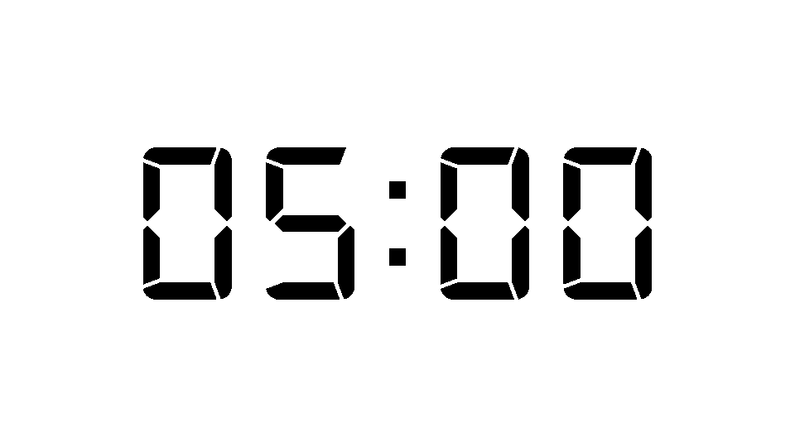
5 Minutes Timer

